Slide 1
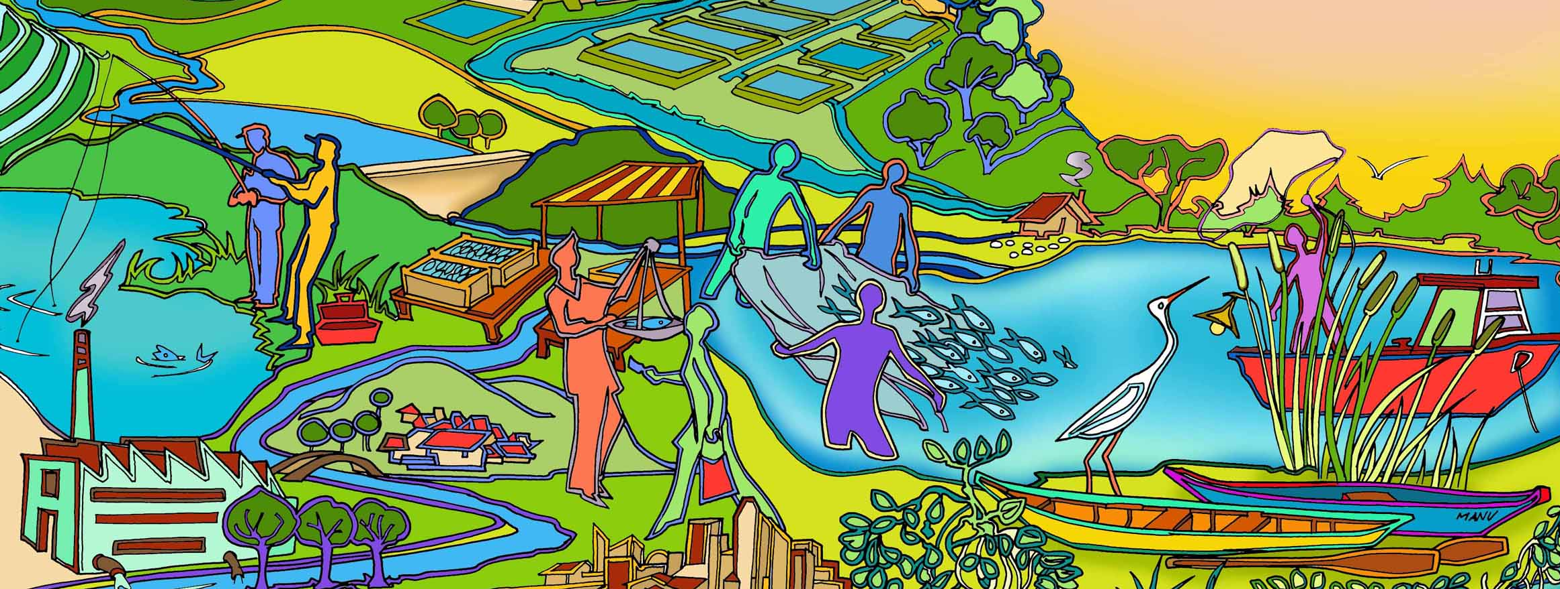
Session 5
Moving towards EAFm
Essential EAFm training
Date |Place

Slide 2
Session objectives
After this session you will be able to:
Recognize how other countries are moving towards EAFm principles (case study - linking fisheries, environment and socio-economic considerations)
Determine your country progress towards EAFm
Identify your country challenges to achieving this
Notes:
The session has 3 objectives;
The selected case study experience relates to 1st objective and to guide the 2nd and 3rd objectives.
Objectives 2&3 are addressed through activities

Slide 3
Case Study
Use selected case study
Notes:
Note to trainer: use the selected case study PowerPoint presentation.
Keep the last 3 activity slides.

Slide 4
Discussion in groups
What key lessons (good or bad) for your country situation can you draw from the case study?
Notes:
At table groups participants discuss lessons from the case study which could apply to their country fisheries; trainer elicits an example from each table in plenary. This activity helps make the case study meaningful to participants; they immediately have to relate the case study example to their own country fisheries.

Slide 5
Activity 1
Each group receives a card that displays one EAFm principle (some groups may have to consider two principles).
In groups, discuss and score where you think your COUNTRY is along the continuum 0-5 for that principle (see Workbook p.5).
Using the lines set out on the floor, one representative for each principle paces out their score while holding the card.
Notes:
See Session Plan for details. 1. For 10 minutes, participants work as a group to establish their score for their allotted principle.
2. Using the lines set out on the floor, one representative for each principle paces out their score while holding the card.
The purpose of this activity is for the whole group to get a sense of how each participant country is performing in relation to each of the 7 EAFm principles. Trainer can elicit comments/ thoughts from the group.

Slide 6
Activity 2: in groups
Identify the challenges your country might face in moving towards EAFm
Write each challenge on a card. (ONE challenge per card)
Now identify opportunities your country may have in moving towards EAFm (and in meeting the above challenges).
Write each opportunity on a separate card
Notes:
1. Participants share initial ideas with neighbour (in pairs)
2. As a group, identify and write 2-3 constraints (challenges) THEIR COUNTRY might face in trying to move towards EAFm (refer to output from activity 1). Write only 1 challenge per card, on e.g. green cards.
3. Get same groups to identify opportunities (write these on different colour cards, e.g. yellow). A challenge in one country may be an existing opportunity in another.
4. Get all groups to walk to back of the room and place constraints and opportunity cards on the floor (directly on the floor, or on 2 differently-labelled flipcharts).
5. Trainer groups cards (on floor, with all participants helping) and facilitates a brief discussion. Ask participants to match opportunity cards to challenges cards if possible. Have brief discussion about overcoming challenges- elicit ideas from participants (linking to local/country continuum table produced earlier on flipchart, as well as threats and issues from day 1).
After the activity, trainer sorts cards and keeps outputs for days 3 and 4 (see session plan).
Possible challenges for countries moving to EAFm: lack of funding; lack of government structures; lack of government support; corruption; short term government posts (i.e. reflect short term perspective only); misconception about management structures needed; decentralisation means responsibility is passed on; weakness of fisher associations/ groups; hierarchical social structure (i.e. does not favour stakeholder participation)…

